Slide 1
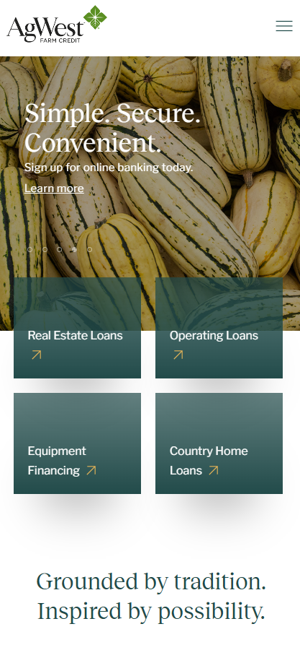
AgWest Farm Credit Website
Business Need
AgWest Farm Credit (AgWestFC) was formed through the merger of Northwest Farm Credit Services and Farm Credit West, creating the need for a new website that represented a unified brand and delivered a modern, intuitive digital experience. The organization required a fully custom Sitefinity solution that supported complex integrations, streamlined online banking access, and enabled a smooth transition from legacy systems, all within a compressed timeline driven by third-party design dependencies.
What We Did
Designed and built a fully custom Sitefinity website aligned to AgWestFC’s new brand identity
Implemented reusable templates and core components including navigation, headers, and footers
Developed key pages and user flows for both new and existing customers
Built custom form components and a login wizard with product-based redirection
Migrated content and user data from legacy platforms and databases
Integrated branch location search, cookie management, and metadata configuration
Results
Launched a unified digital platform that clearly reflects AgWestFC’s new brand and structure
Delivered a simplified, user-friendly online banking and navigation experience
Enabled a seamless transition from legacy systems through reliable data migration and integrations
Established a scalable Sitefinity foundation to support future enhancements

Slide 2
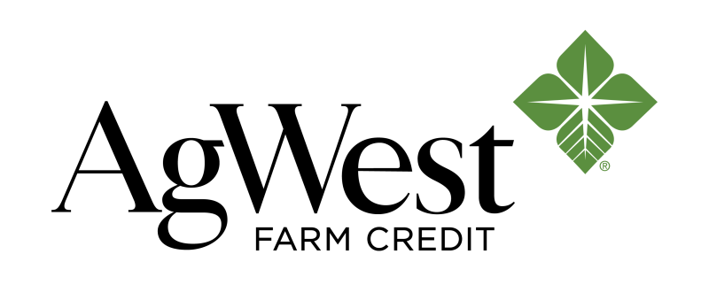
AgWest Farm Credit Services – Website Development
Business Need
AgWestFC is a newly formed financial cooperative resulting from the merger of Northwest Farm Credit Services (Northwest FCS) and Farm Credit West (FCW). They needed support developing a website for AgWestFC that reflects the new brand identity and enhances user experience, especially for online banking. The new website required a fully custom design, complex integrations, and a user-friendly navigation & login experience for online banking customers.\
Challenges and Solutions
Brand Integration: Merging two distinct brands (NWFCS and FCW) required careful planning and execution to ensure a seamless user experience and brand consistency.
Complex Integrations: Ensuring smooth data import from various sources (legacy Sitefinity, various databases) required planning and execution.
Tight Timeline: A significant portion of the work dependent on timely delivery of designs and wireframes from integrated third-party designs
What We Did
Website Development:
  Built a new Sitefinity site
  Implemented templates and core components (header, footer, navigation, etc.)
  Developed core pages for both new and existing customers
  Created a form component and login wizard with product redirection
  Imported existing user data
  Integrated Google Maps for branch search and directions
  Managed cookies and metadata
Results
The new AgWestFC website was successfully launched, leading to enhanced user experience and seamless brand integration that reflected AgWestFC’s new identity.

